Slide 1
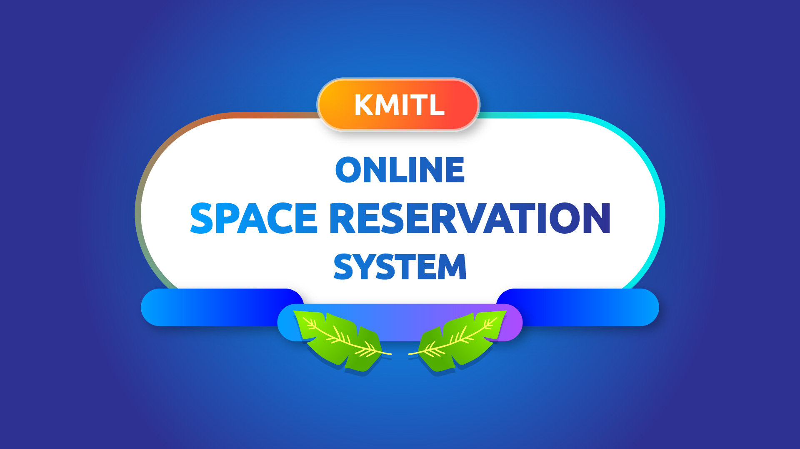

Slide 2
Why?

Slide 3
13
6
interviews
departments
Notes:
10+ interviews across 5 faculties

Slide 4
Cons of the old system
Long process
Boring form-filling
Manual schedule management
Paper wastage

Slide 5
Goals of the new system
Short and easy process
Less form-filling
Automatic schedule logging
Be paperless

Slide 6




API server
Web server

Slide 7
Challenge:
How to authenticate a user securely and simply?
Solution:
LDAP.

Slide 8
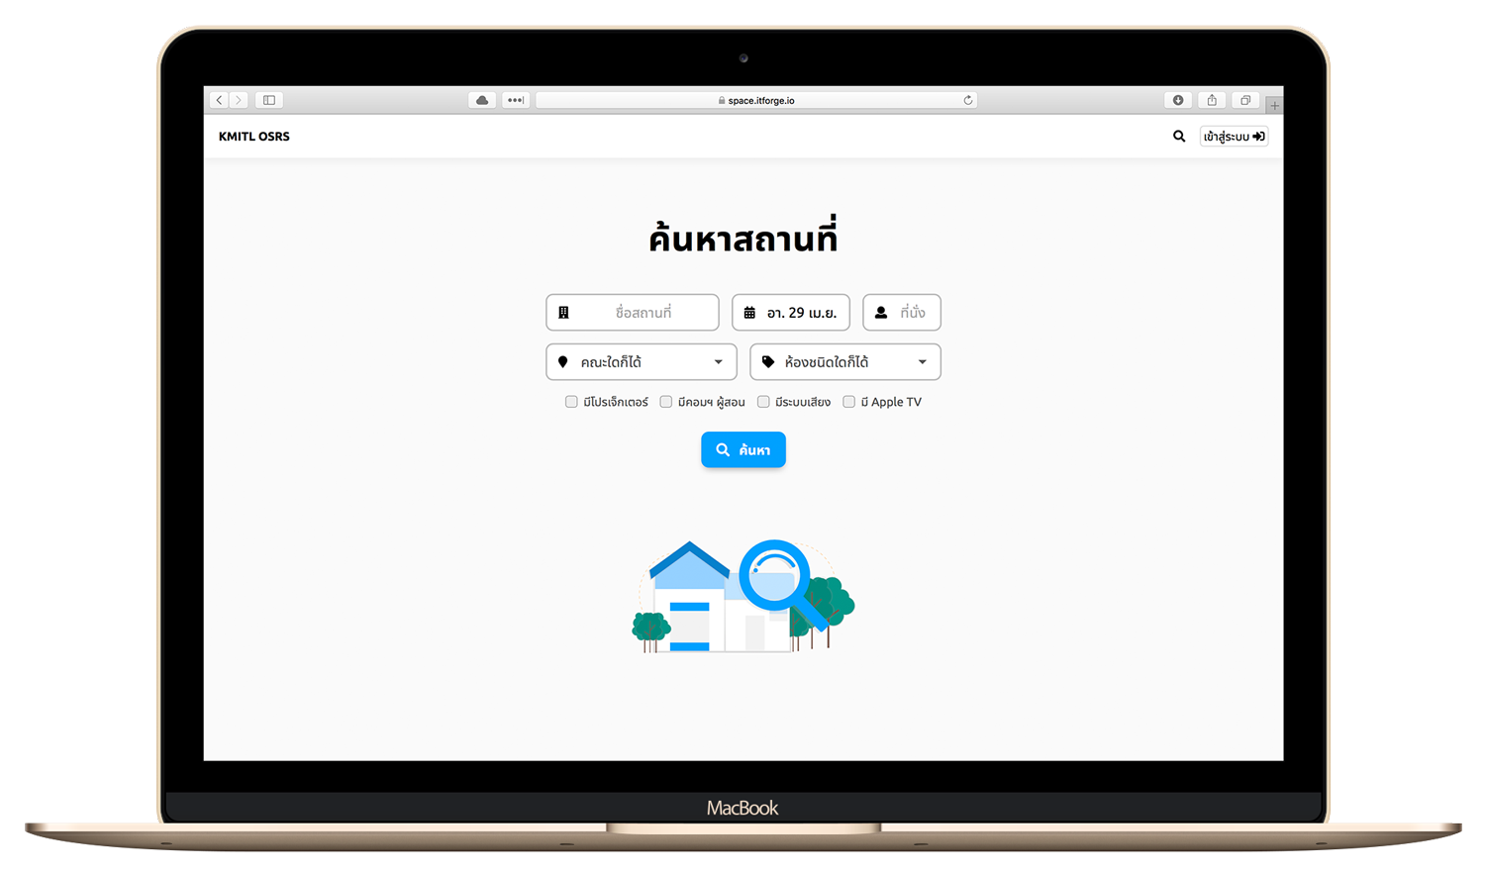
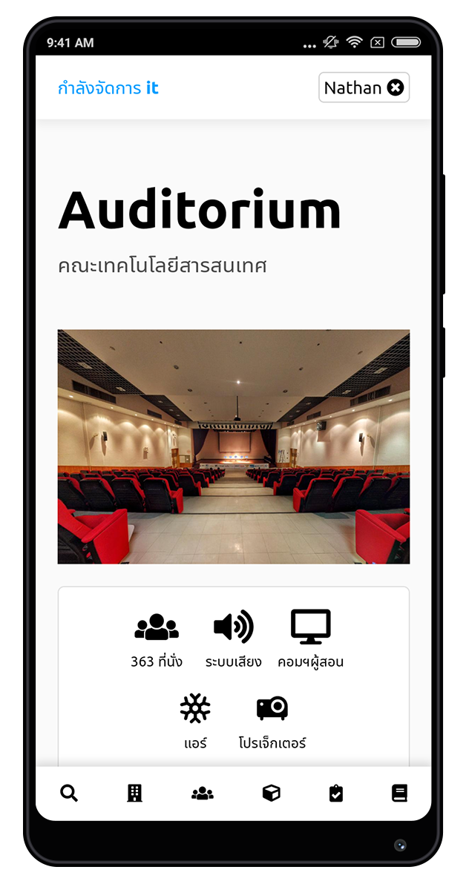

Slide 9
Demo
space.itforge.io

